Slide 1

Outpatient Opioid Prescribing
Outpatient Supportive Care Medicine Didactic Series
Notes:
Narration transcript: This session is intended to introduce you to the scope of outpatient palliative care and when it will be appropriate to refer your patient to this specialty field. Outpatient palliative care provides specialized medical care for people with serious, chronic, or life-limiting illnesses, focusing on improving quality of life for both patients and their families. The care team manages symptoms like pain, nausea, and anxiety while offering emotional, psychological, and spiritual support. The care team also helps with addressing goals of care to ensure treatments align with the patient's values and preferences. Education is provided to patients and caregivers about their illness, treatment options, and symptom management. Social and spiritual needs are also addressed, including connecting patients to community resources and providing caregiver support. Outpatient palliative care aims to reduce hospitalizations and enhance patient satisfaction by focusing on care coordination, comfort, and quality of life.

Slide 2
Learning Objectives
    At the end of this session, learners will be able to:
Describe 3 unique aspects of outpatient opioid prescribing
List 3 risk factors for opioid addiction and 2 ways to mitigate them
Describe at least 2 limitations of outpatient opioid prescribing

Slide 3
Sample case
55 year old male with HTN, DM type 2, pancreatic cancer diagnosed a few weeks ago
Oncologic history:
- Diagnosed late 2024
- Started FFX, consideration given for surgery and RT
- No complications with treatment so far

Slide 4
Pain assessment
- OPQRST = onset, provoking/palliating, quality, radiation, severity, time/duration
- CLODIERS = characteristic, location, onset, duration, intensity, exacerbating/remitting factors, related symptoms
- OLDCARTS = onset, location, duration, character, aggravating factors, relieving factors, treatment

Slide 5
Pain assessment
- Located in abd. Described as deep, dull pain. Sometimes radiates to back
- Getting more persistent. 10/10 at its worst and typically 7-8/10
- Has tried Tylenol and Motrin with no real relief
- Affecting sleep, ability to work, ability to interact with friends/family
- No identified factors that make pain better or worse

Slide 6
Objective exam
- Uncomfortable but no acute physical distress
- Vitals stable
- Abd tender with deep palpation
- Otherwise unremarkable
- Last CT shows known cancer; no other findings

Slide 7
Assessment
- Chronicity/acuity
- Type of pain
- Etiology
- Controlled or uncontrolled?

Slide 8
Assessment
- Chronicity/acuity - acute
- Type of pain - visceral
- Etiology - cancer related
- Controlled or uncontrolled - uncontrolled

Slide 9
Starting opioids
- WHO pain ladder, rationale for using opioids
- Risk assessment; consideration of opioid agreement/urine tox screening
- Choice of medication
- Counseling
- Addressing concerns

Slide 10
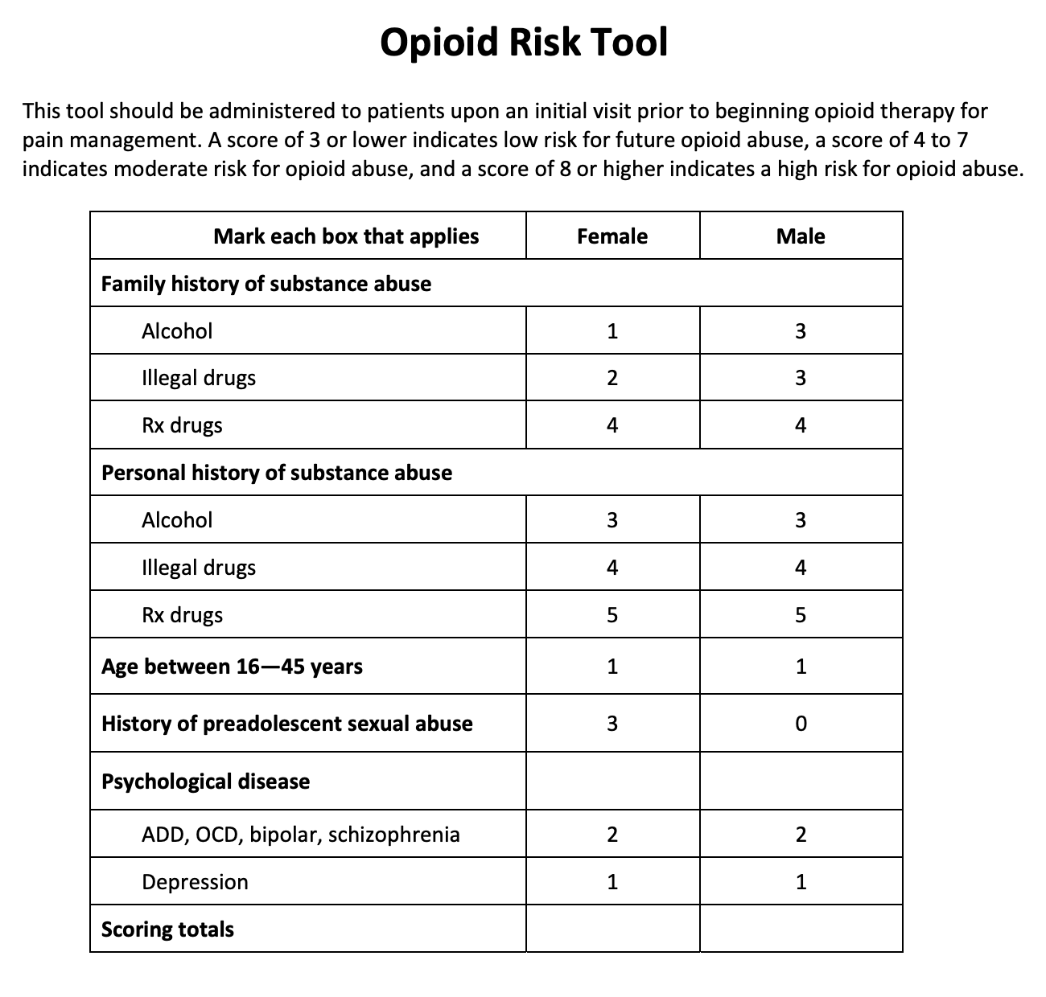
Opioid risk assessment tool

Slide 11
Plan of care
- Oxycodone IR 5mg PO q4h as needed for pain OR morphine IR 7.5mg PO q4h as needed for pain. Remember to give plenty of medication to last until follow up. In this case, our patient can use up to 6 tablets per day. If follow up is in 2 weeks, that’s 6 tablets x 14 days = 84 tablets. We can also consider giving a few extra tablets.
- Goal is at least 2-3 good bowel movements per week. Low threshold to start Senna 2 tabs OR MiraLAX daily
- Follow up 1-2 weeks

Slide 12
Follow up visit
- Ask about medication effects
- Ask about side effects
- Ask about functional changes
- Ask about any other symptoms and psychosocial issues (ex: mood)

Slide 13
Follow up visit
- Ask about medication effects - helps for about 4 hours, needing to take it regularly
- Ask about side effects - had constipation, added MiraLAX and doing better
- Ask about functional changes - better able to work, interact with friends/family
- Ask about any other symptoms and psychosocial issues (ex: mood) - sleep better since pain better controlled

Slide 14
Follow up visit
- Using oxy IR 5mg x 6 times/day = 30mg total. Pain is persistent, LA opioid is appropriate
- START oxy ER 15mg PO q12h
- CONTINUE oxy IR 5mg PO q4h PRN mod/severe pain
- CONTINUE MiraLAX daily
- Follow up 3-4 weeks

Slide 15
Differences in outpatient practice
- Opioid agreements and urine tox screen (not typically done during inpatient)
- Opioid risk assessment tool
- Prescribing Narcan (see instructional video here)

Slide 16
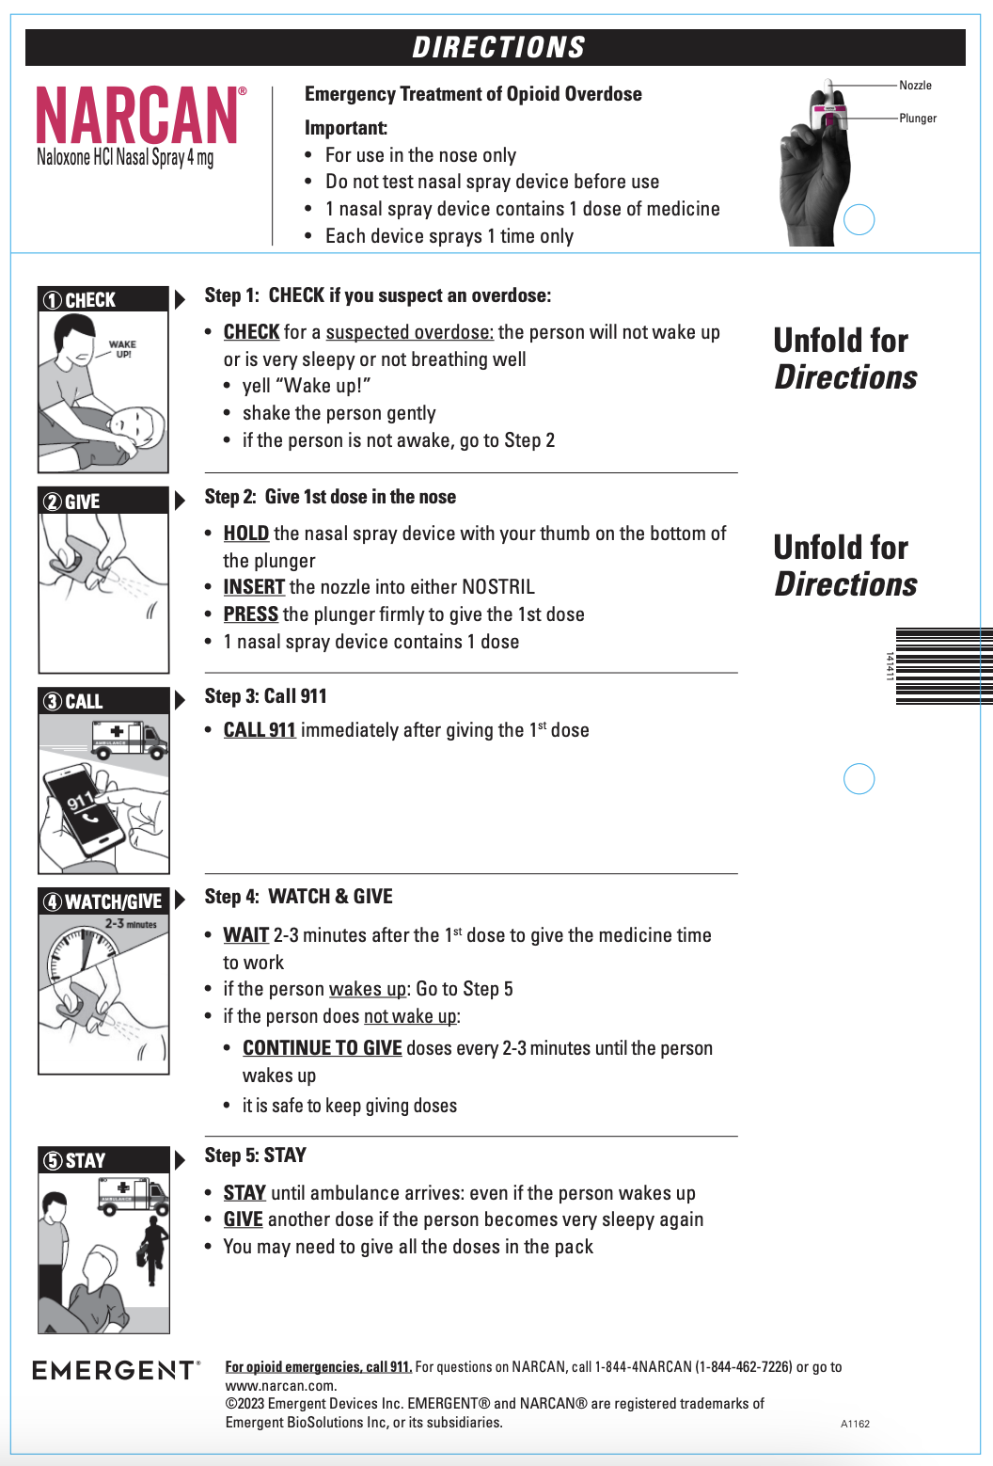

Slide 17
Challenges in outpatient practice
- Potentially having multiple clinicians prescribing medications
- Pharmacies not open 24/7
- Pharmacy <> clinician communication not ideal
- Patients live all over — finding medication supply can be difficult
- PA, formulary issues

Slide 18
Thank you!

Slide 19
Please complete the short knowledge check-in below
Quiz: https://forms.gle/a2znbFTZXu2qRxMr6
Answer key/Feedback: https://forms.gle/DfiAQeqgqUPRjYXR6

