Slide 1

Introduction to Advance Directives vs POLST
Click here for narration
Outpatient Supportive Care Medicine Didactic Series
Notes:
Narration transcript: This session will introduce you to the basics on an advance directive and the POLST, the similarities and differences between them, as well as guidance about how to counsel patients on completing both. Before we start, a quick note about terminology– for the purposes of this presentation, advance directive only refers to forms that let patients assign health care agents (AKA healthcare power of attorney) and/or document their healthcare preferences (AKA living will) and does not include the POLST. I make this note because sometimes the term advance directive is used more broadly and will include all formal ACP documentation including the POLST. Here though the term advance directive and POLST will refer to two separate documents

Slide 2
Learning Objectives
    At the end of this session, learners will be able to:
Compare the type of information documented in an advance directive vs a POLST
Choose the appropriate type of advance care planning document (POLST vs advance directive) depending on what is being documented and the clinical context
Describe how to submit an ACP bill for advance care planning conversations
Counsel a patient on completing an advance directive and a POLST

Slide 3
Advance Directive: Introduction
An advance directive is a written document in which an individual appoints a person or persons to make health care decisions (A.K.A. healthcare power of attorney) AND provides guidance for health care decisions (A.K.A. living will)
EVERYONE should be encouraged to complete an advance directive
What is an advance directive?
Who should have an advance directive?
Click each question to see the answer
Notes:
We’ll start with the advance directive.

Slide 4
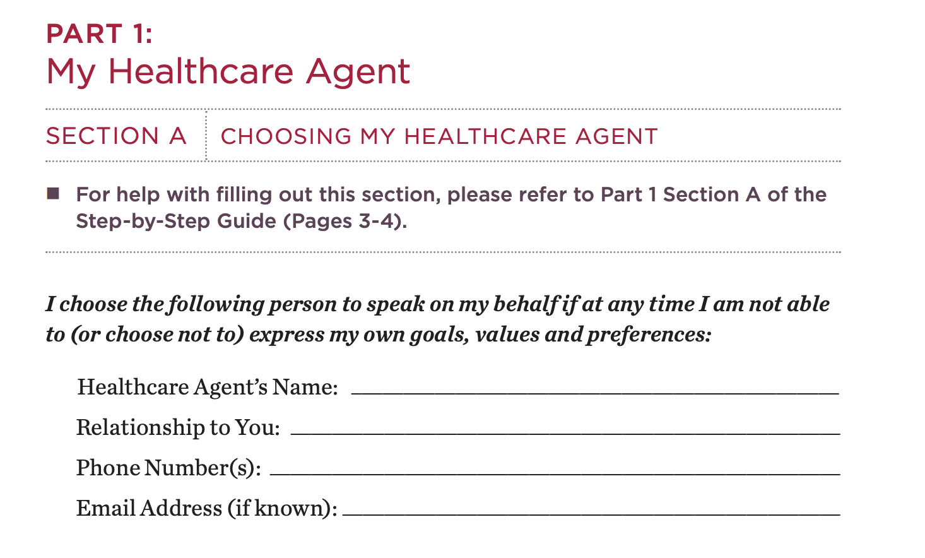
Advance Directive: Sections
Click here for narration
Part 1: Choosing a healthcare agent
Designating a healthcare agent is LEGALLY BINDING
Notes:
Narration transcript: The next two slides outline the main sections of the advance directive. The first section is designating a healthcare agent. If you click on the slide, you’ll see the portion of the Cedars advance directive which allows patients to assign someone to be their healthcare agent. You should counsel patients to choose someone that knows them well and that they trust of make decisions on their behalf if they were too sick to decide for themselves. Healthcare agents have authority to make medical decisions on someone’s behalf while they are alive AND are authorized to make after death arrangements. Designating a healthcare agent is legally binding which means that if there is unresolvable conflict amongst the patient’s support system about decision making, the healthcare agent is the only one with legal authority to make decisions

Slide 5
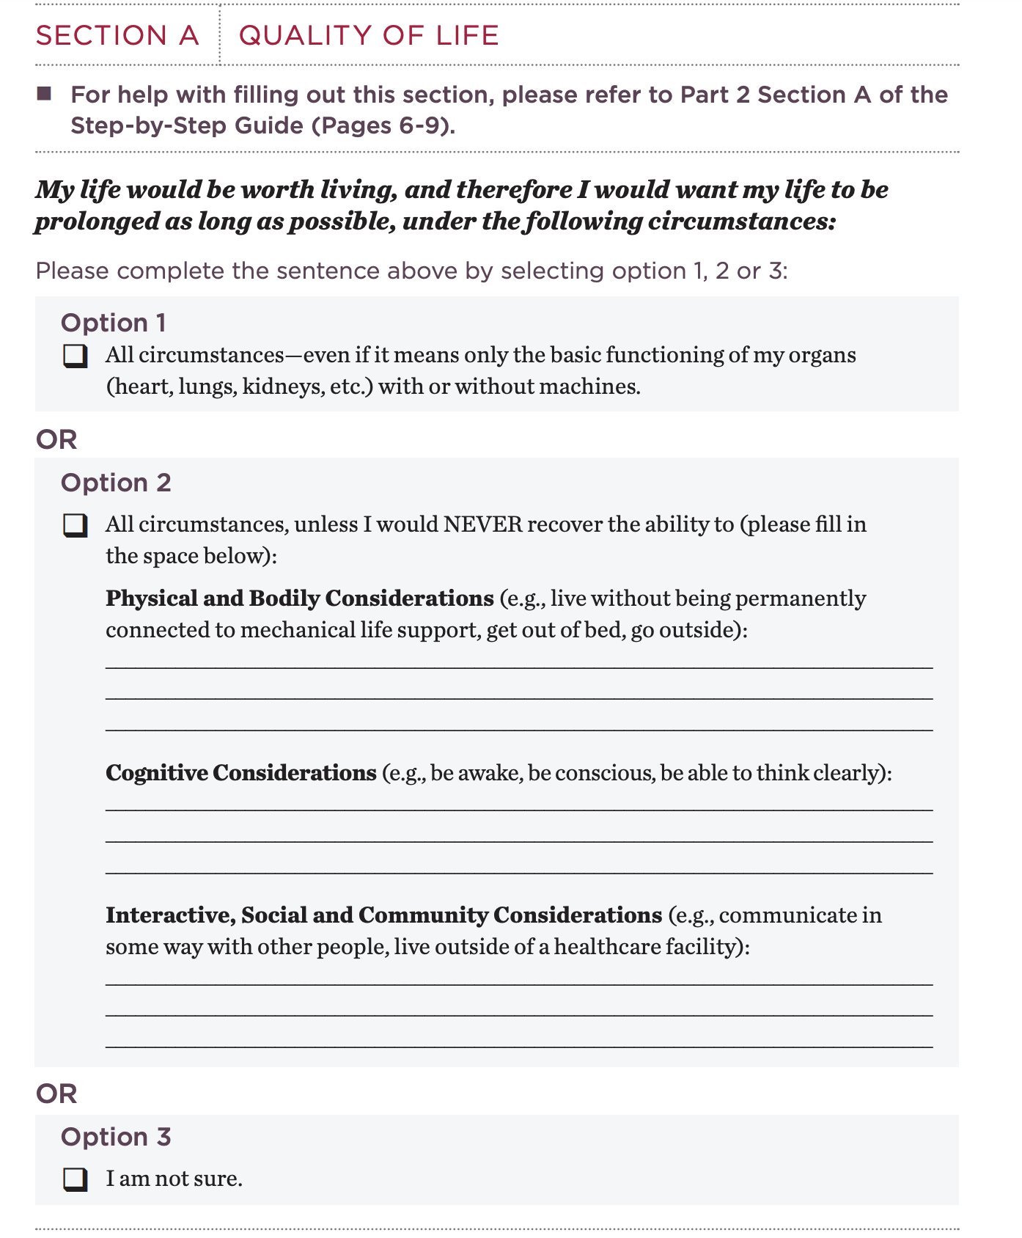
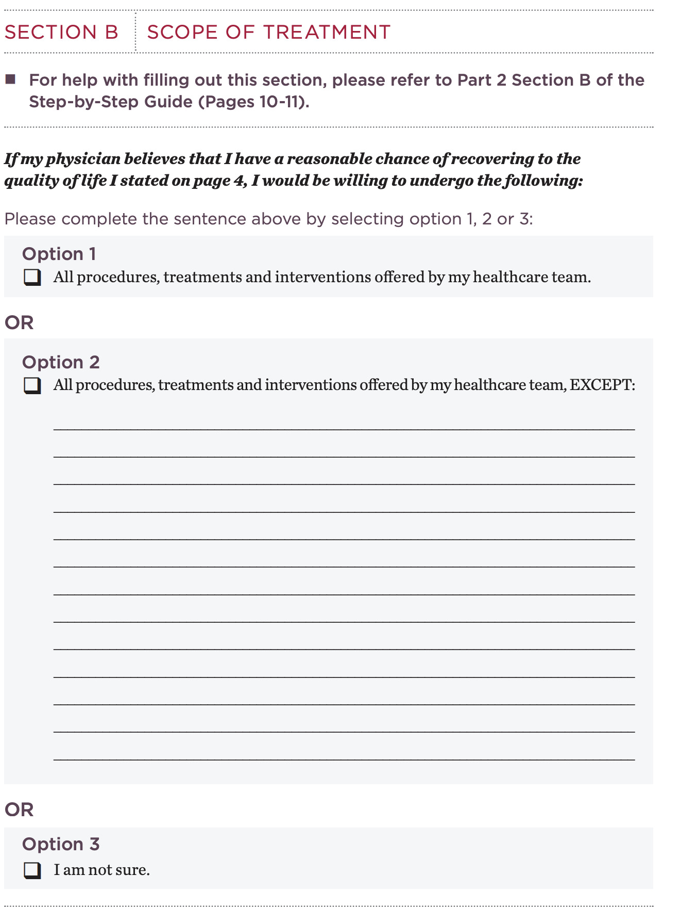
Advance Directive: Sections
Click here for narration
Part 2: Guidance on healthcare decisions
Preferences regarding healthcare decisions are LEGALLY RECOGNIZED not LEGALLY BINDING
Notes:
Narration transcript: The second section of the advance directive lets patients give their healthcare agent and medical team guidance about how they want decisions made. If you click on the slide, you’ll see the portion of the Cedars advance directive that lets patients document their acceptable quality of life and acceptable scope of treatment. Unlike the healthcare agent designation, preferences regarding healthcare decision are legally recognized not legally binding. This means that although the healthcare agent and medical team will do their best to honor what’s written in the advance directive, there may be circumstances where the patient’s wishes cannot be followed exactly because of medical appropriateness. It’s important to highlight this fact to your patients and encourage them to talk directly with their healthcare agents about their values and priorities in addition to documenting them in an advance directive

Slide 6
POLST: Introduction
An POLST consists of a set of medical orders that address a limited number of critical medical decisions
Who should have a POLST?
What is a POLST?
Patients with a serious, life limiting illness
Click each question to see the answer
Notes:
who should speak for you and

Slide 7
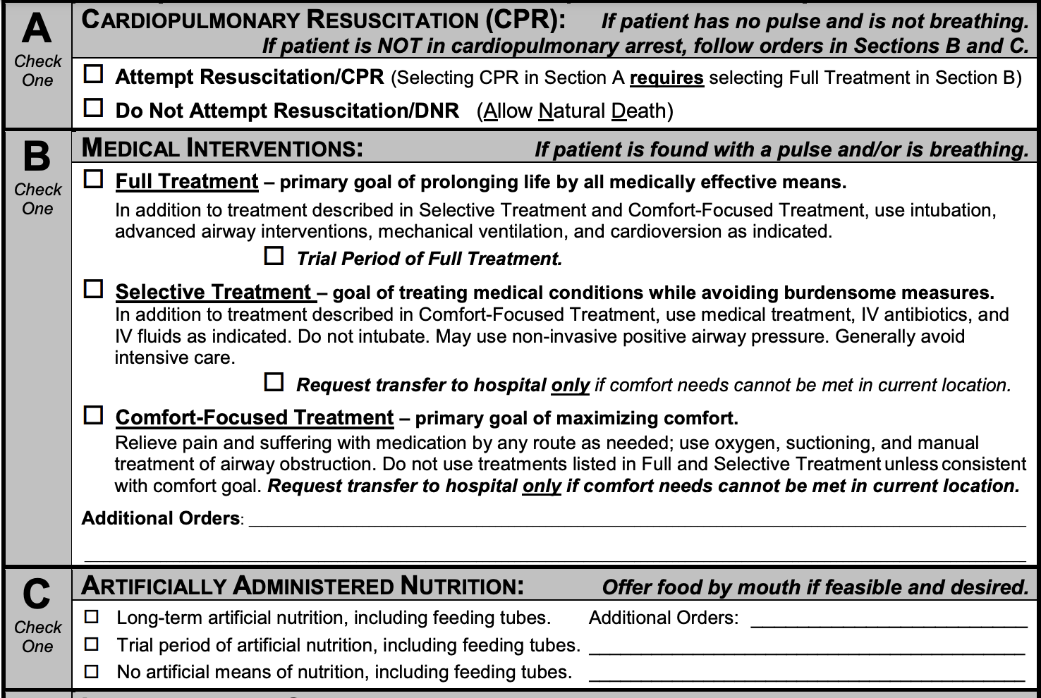
POLST: Sections
Click here for narration
Section A = Code status
Section B = Level of acceptable medical intervention (N.B. If patient selects attempt resuscitation in section A, MUST choose Full Treatment in section B to make it valid
Section C = Preferences regarding artificially administered nutrition
Notes:
Narration transcript: Next we will talk about the POLST or Physician Order for Life Sustaining Treatment. This slide shows the California POLST - it is a set of medical orders regarding critical medical decisions and can be used by emergency medical services. The California POLST has three sections – the first section lets patients document their preference regarding CPR and gives them the option of choosing attempt resuscitation or allowing a natural death. The second section asks patients what level of medical treatment is acceptable. The options given are full treatment which generally includes intubation and ICU transfers, selective treatment, and comfort focused treatment. Unless patients are also electing hospice, I generally advise against selecting comfort-focused treatment even if symptom management is one of their priorities. Otherwise there is a risk that patient’s designation of comfort focused treatment is misinterpreted during emergency situations. It should also be noted that it patients select attempt resuscitation in section A, they must choose Full treatment in section B to make it valid. Finally the last section asks about preferences regarding artificially administered nutrition

Slide 8
Advance Directive vs POLST
Click here for narration
 | ADVANCE DIRECTIVE | POLST
Who should have one? | Appropriate for all adults over 18 | Only appropriate for those with a serious, life-limiting illness
What is included? | Includes designation of health care agent and guidance on healthcare decisions | California POLST includes medical orders for resuscitation, level of medical intervention, and artificially administered nutrition
How is it legalized? | Either by notary or two person witness | Requires physician/APP signature AND signature from patient or their decision maker
Notes:
Narration transcript: Now that we’ve reviewed the basics of the advance directive and POLST, let’s compare them head to head. The tables in the next two slides review the main differences between an advance directive and POLST. Having seriously ill patients complete an advance directive and POLST is reasonable since they serve different although complementary purposes. Again the advance directive lets patients designate a health care agent while the POLST translates critical medical decisions like a decision for do not resuscitate into a medical order. This slide reviews who should have each type of document, what is included, and how it is legalized

Slide 9
Advance Directives vs POLST
Click here for narration
 | ADVANCE DIRECTIVE | POLST
Which sections are legally binding? | Only designation of health care agent. Guidance on healthcare decisions is legally recognized, not legally binding and CANNOT be used by EMS | All sections function as medical orders and CAN be used by EMS
Who can create or change the documentation? | Only the individual can create or change the documentation | Both the individual and their healthcare agent can create, modify, or void a POLST form
When should it be revised? | Reviewed and updated if appropriate at least once e year or when a significant life even occurs, especially with major changes in the patient’s health | Revise if there are changes to preferences or tolerable burdens (e.g. change from full code to DNAR)
Notes:
Narration transcript: This slide continues the comparison between advance directives and POLSTs and reviews which sections are legally binding, who can create or change the document, and guidance on when it should be revised.

Slide 10
Billing for Advance Care Planning
Click here for narration
Medicare definition: “Care you would want to receive if you became unable to speak for yourself including the explanation and discussion of advance directives”
Document content of conversation, who was present, including the patient, and total time in minutes including start and end times
No limit to number of times the code may be billed for the patient, as long as documentation demonstrates repeated discussions are associated with a change in health status or directive
Notes:
Narration transcript: The next two slides review how to bill for advance care planning conversations. Medicare defines advance care planning as care you would want to receive if you became unable to speak for yourself. Although it is not required that formal ACP documentation like an advance directive or POLST be completed at the end of the visit, you are reviewed to document what you discussed, who was present for the conversation, and the total time you spent. You can submit an ACP bill as many times as you want for a patient as long as documentation supports that the discussion is associated with a change in health status or directive

Slide 11
ACP Billing Codes
Click here for narration
CPT Code | Description | Time based coding thresholds | RVU
99497 | First 30 minutes (at least 16 minutes of time spent in ACP) | 16-45 minutes | 1.5
99498 | Additional 30 minutes (at least 16 minutes beyond first 30 minutes) | 46-75 minutes | 1.4
Notes:
Narration transcript: This slide gives the amount of time you need to spend on advance care planning in order to submit the ACP billing codes. In order to submit a 99497 bill, at least 16 minutes of your visit must be spent on ACP content. If you spend more than 46 minutes on ACP content, you can submit both a 99497 and 99498 bill

Slide 12

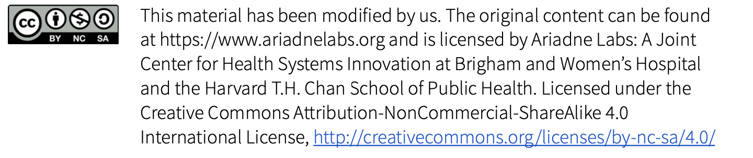
Meet Susan
Response: I would like to talk together about the future with your health and what matters to you. Would this be okay?
Rationale: Signpost to introduce a new topic and to give your patient a moment to prepare for the shift
Susan is a 55 y/o woman with advanced heart failure (EF 20%) who has been stable on GDMT.
She is here for her annual visit
After reviewing her current conditions, you decide to include advance care planning on your visit.
How could you add advance care planning to the agenda?
Click to see the suggested response and rationale

Slide 13
Naming a surrogate decision maker
During the conversation, you bring up the importance of naming a surrogate decision maker.
You say: One thing I discuss with all of my patients is who they would trust to make medical decisions on their behalf if there were periods of time they couldn’t talk to us directly. Is this something you’ve thought about before?
Susan says: I haven’t really thought about it. I’m hoping that it won’t be necessary and if it does, I’ll cross that road when it happens
How would you respond?
Response: I hope you stay well for a long time. That is what I’m hoping for and will continue working towards that goal. AND it sometimes happens that there are periods where people can’t tell us what decisions make sense for them so it is important that we know who you trust to best represent you and to speak on your behalf
Rationale: Frame conversation as “hope for the best AND plan just in case something happens”
Click to see the suggested response and rationale

Slide 14
Naming a surrogate decision maker
Susan says: The main people in my life are my husband and my daughter. I’m not sure which one I should choose
How would you respond?
Response: Some people choose their spouse and some people choose one of their children. What’s more important is that you designate someone who knows you well and who you trust to make important health care decisions for you
Rationale: Use the discussion about surrogate decision makers as an opportunity to reinforce the surrogate decision maker role
Click to see the suggested response and rationale

Slide 15
Naming a surrogate decision maker
You should recommend that Susan complete an advance directive to designate her husband as her healthcare agent`
Susan says: Based on that, I think my husband makes sense.
What documentation should you now recommend that you and Susan complete?
Click to see the suggested documentation

Slide 16
Please complete the short knowledge check-in below
Quiz: https://forms.gle/rCqMVZJeMAWM4hWU7
Answer key/ Feedback: https://forms.gle/koWF2DnbD4pxuATq6

